Slide 1


SUSTAINABLE OUTREACH AND UNIVERSAL LEADERSHIP (SOUL) LIMITED Empowering Humanity….

Slide 2
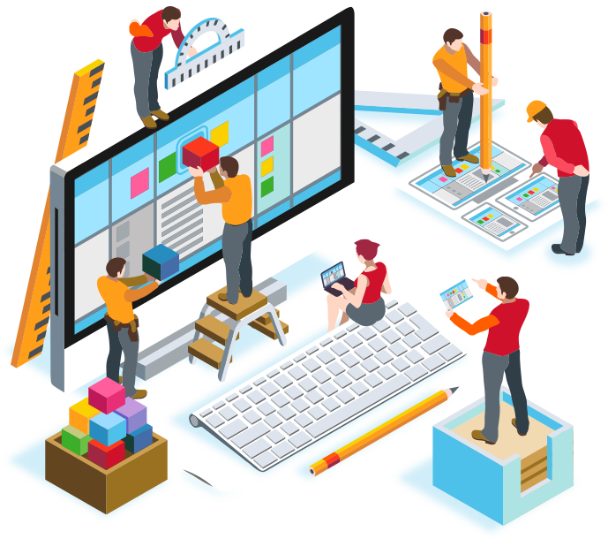
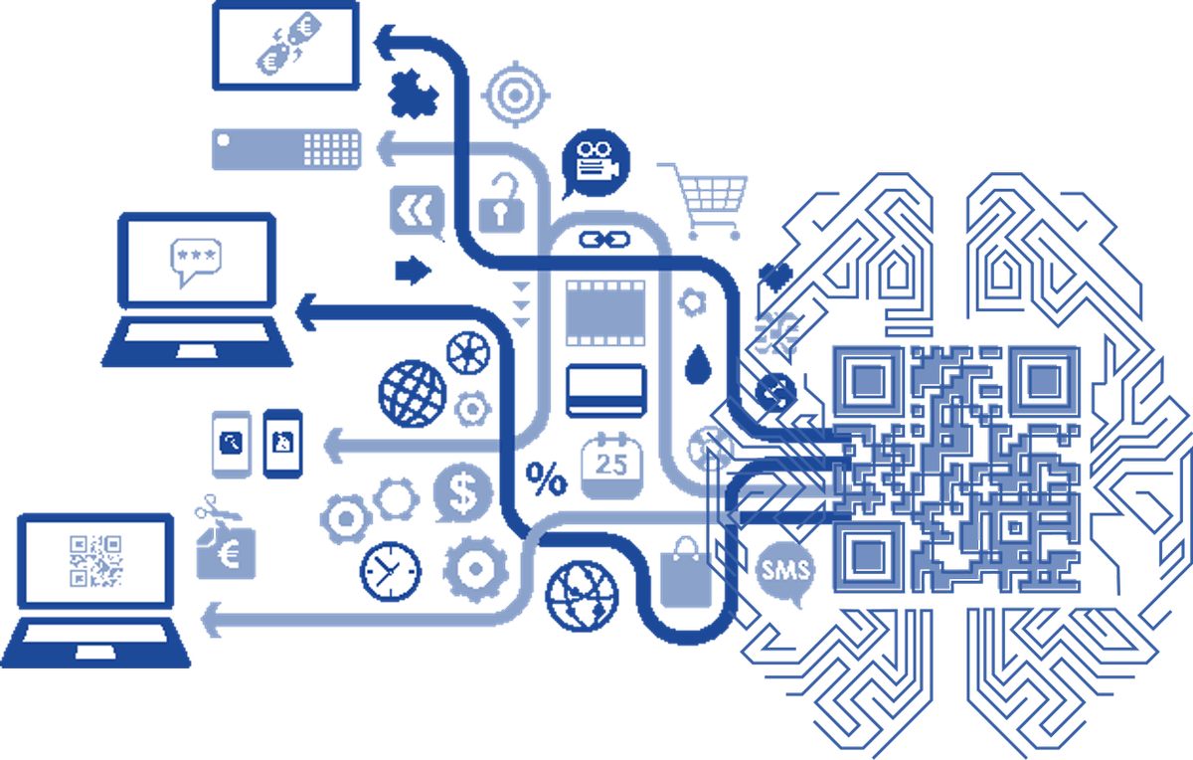
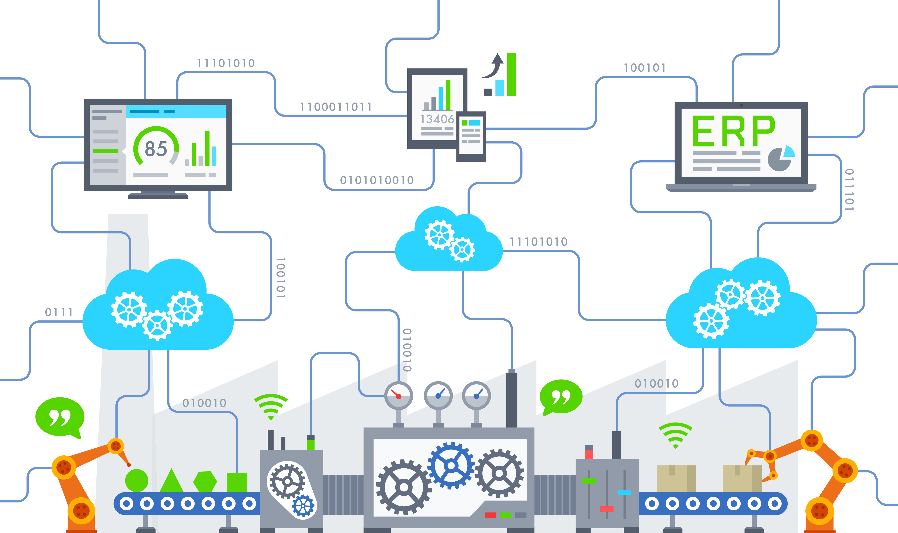



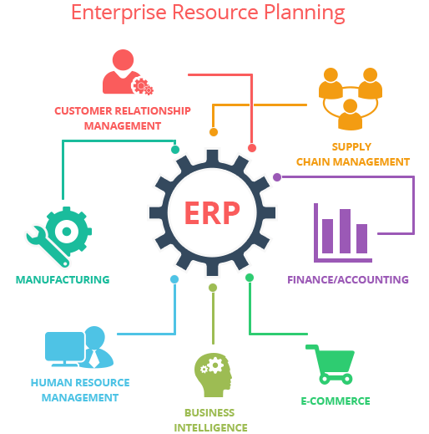
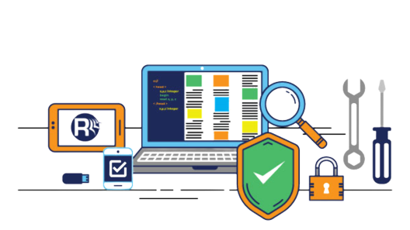
 | Application Development & Support |  | Data Analytics using AI-ML
Smart Infrastructure using IOT |  | Cloud Computing
 | Robotics |  | Consulting
ERP |  | Software Validation & Testing
Service Offering

Slide 3





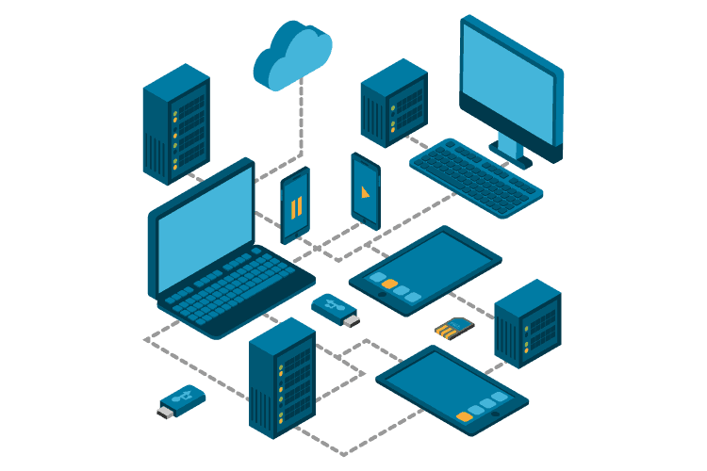
Solution Implementation Follow Industry best practices.
Use the latest technologies.
Continuous delivery with Agile approach.
Digital Consulting By Domain and Tech Experts
Business Blueprint.
Identify business gaps and provide solutions to maximize ROI.
Help figure the right technology solution for your business.
Application Validation With Test Specialists
Full spectrum of test services.
Automation and Performance testing.
Program Management
Infrastructure
Management
Scalable Architecture.
Cloud Infrastructure services.
DevOps.
Server and Database Management
Insights with Data Experts
Data Architecture and Management
Dashboard and Visualization.
Advance Analytics using AI/ML

Slide 4

Project Execution Methodology
Agile Development
Continuous Integration
Commit Build + Unit Test + Static Code Analysis
Product
Backlog
Sprint
Backlog
Sprint
Potentially Shippable Product
CI Server
Dev
Code Repo
Artifacts
Burndown Chart
Epics / User Stories
Bugs/ Issues
Sprint Review
Monitor
Ops
Development
Environment
Repo. Manager
Continuous
Integration
Daily Scrum
Agile DevOps
Continuous
Testing
Continuous Delivery
Sprint Phases
Continuous Testing
Approve
Ops
Continuous
Delivery
Build
QA
Commit
Ops
PO, PM
Monitor
Deploy
Code Repo
Test Script
Dev
Report
Issue Tracking
Artifacts
Test Suite
End User
Production Environment
Deploy
Repo. Manager
CI Server
Staging
Environment
Repo Manager

Slide 5
Architecture
MariaDB
NGINX
Apps
Sites
Log
scheduler.log
Frappe
App-1
Site-1
Site-2
frappe.log
worker.log
Postgre
Supervisor
App-2
App-3
Site-3
Site-4
Scheduler.log
custom.log
Services
Config
Redis
Python
Env
pids
supervisor.conf
bin
lib
share
redis.conf
nginx.conf
Wkhtmltopdf
Node.js
Yarn
Bench
Excecutables

Slide 6






Infrastructure
Intranet
Server
Source
Repository
Remote work location
Data on Cloud
VPN over Internet
Firewall
Firewall
Router
Firewall
SOUL Office
Client Network
SOUL

Slide 7


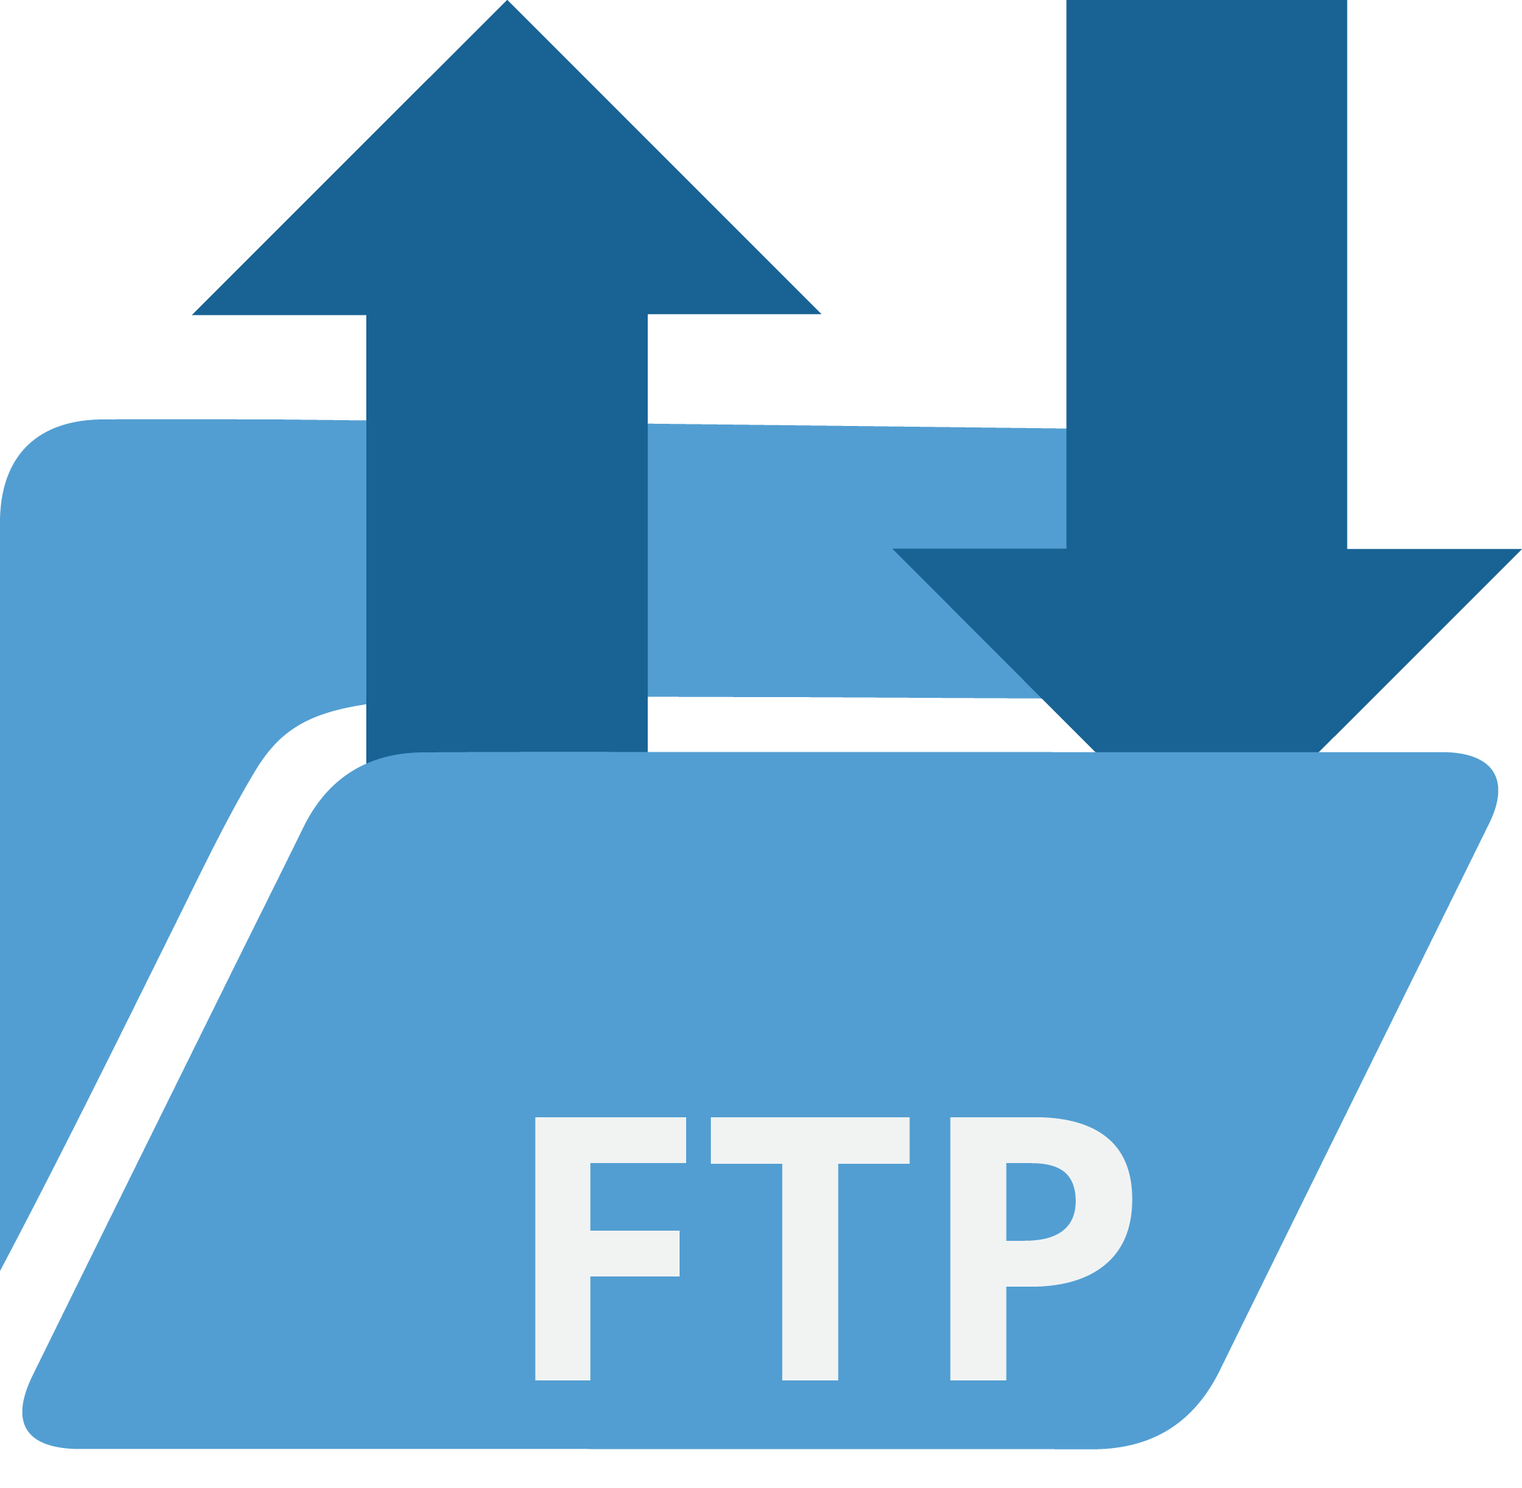





Communication Tools
Value in team knowledge sharing
Travel
Document
Intranet
Forum
Video Conferencing
Email
Phone
Chat
Usage Frequency

Slide 8











PMU software for Smart Class Implementation Project
Web based application to conduct survey and collect data to provide inputs for workforce management
Challenges
Solution Highlights
Implemented for more than 2000 class rooms
Web based application to conduct survey and collect data and provide inputs for workforce management
Ability to plan and monitor the project implementation.
Various dashboard for different stakeholders
Mechanism to collect event log data using automated script
ETL Development using ADF to transform raw data to reportable data
Data Visualization using Power BI
Scalable solution to handle Billion+ records
Realtime Implementation data of Installation status
Improper utilization of assigned resources as there was no tool for keeping a record of total Implementations
Issue raised by various schools based on SLA status by keeping record of warranty status
Technologies
Python | JavaScript | Node.js | Vue.js | MariaDB | Azure/AWS | Power BI | Shell Script | NGINX
Improved visibility by providing a comprehensive view of performance of resources. Hence, resulting in Increased efficiency

Slide 9


Custom ERP implementation in a university
Web based Solution for all SLCM, Accounts, HR, Payroll processes in an educational Institute
Challenges
Solution Highlights
Web-based ERP solution to maintain and Manage all data at one place. Thus, there exist no chance for data duplicacy.
Master data that would entered once can be used for all transactional process throughout the system.
Role-wise user access which means users can be restricted as to which form and also which records they can view in the system.
Payment gateway Integration
Comprehensive report generation for different users who can filter and view records based on different criterias
Accuracy of real-time data
Avoiding unauthorized access to critical records
Unavailability of centralized data
Technologies
Python | JavaScript | Node.js | Vue.js | MariaDB | Shell Script | CSS | NGINX
Improved collaboration and efficiency thus enhancing decision making process

Slide 10

Custom ERP Implementation at World Skill Center
Web based solution for streamlining and automating various administrative and operational processes
Challenges
Solution Highlights
Lack of traceability resulting in delay for different day-to-day activities like admission, fee management, etc.
Automation of processes from student admission till they are pass-outs, keeping all data at a single place making easier for all departments to access it
Help institutions optimize resource utilization by providing real-time data and analytics, enabling data-driven decision-making
Reduces paperwork, thus making the process efficient by eliminating manual paperwork
Employee Portal for managing all employee related activities
Managing entire Procurement processes through ERP solution from posting Purchase requisition to Material Issue
Lack of centralized database which contributes to same data being stored at mutliple places
Delay in decision making processes due to abscence of Analytical tools like charts or reports
Manual followup is required for HR processes like leave balance calculation, Reimbursement, etc.
Technologies
Python | JavaScript | Node.js | Vue.js | MariaDB | Shell Script | CSS | NGINX
Comprehensive solution to improve productivity and optimize resource utilization

Slide 11
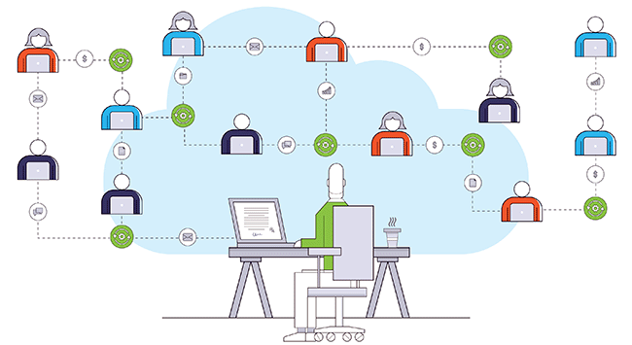
Workflow based Invoice Tracking system for a Medical Institute
Minimized the time taken for Note-sheet Creation, Overall making the payment to the Vendor faster
Challenges
Solution Highlights
Enabled realtime Note-sheet tracking at any point of time by Implementing workflows consisting of different users for Approval at different stages for all Notesheets
Created provision for Reject and transfer Notesheet to any of the employee in Application for Verification
Implemented Email Notification for each transaction
Implemented provision for assigning alternate employee to approve Note-sheets if the assigned employee is absent
Powerful and customization reports are prepared for various processes
Delay in payment to vendor due to multiple approval authorities
Realtime tracking of Invoices
Loss of Invoices
Technologies
Python | JavaScript | Node.js | Vue.js | MariaDB | Shell Script | CSS | NGINX
Improved efficiency for payments to the Vendors

Slide 12
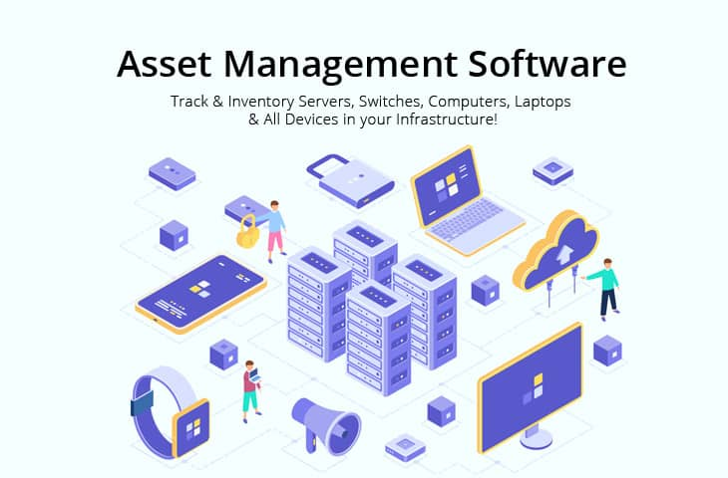
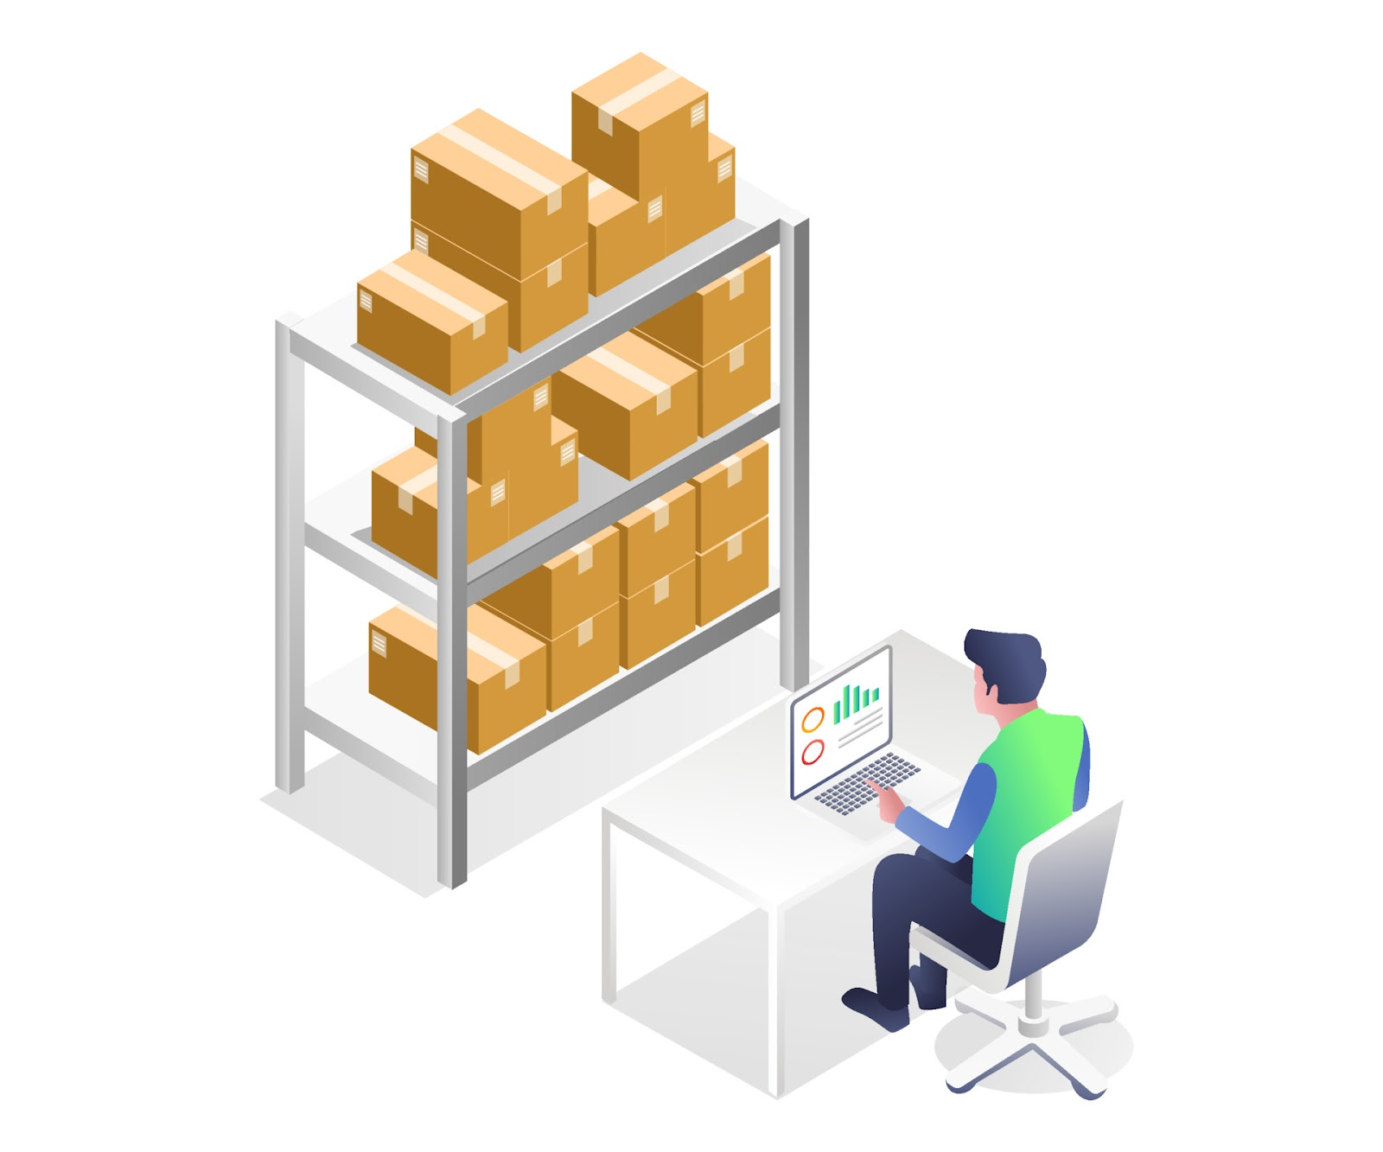




Asset management system for one of the largest private university of Eastern India
Implemented end to end fully automated RFID & web-based solution for movable and rarely movable asset tracking and management system providing asset traceability , movement history and reporting across whole university
Challenges
Solution Highlights
Pilferage / Misutilization of assets
RFID tag-based asset tagging
Segregation of nonmetallic and Metalica surfaces for RFID tags
Entry & exits covered with RFID readers, antenna and alarm system
Web based Interface for asset movement request, approval and bulk asset data insertion
Advanced search facilities such as asset id, location, assigned personnel & movement history
Comprehensive Report generation for user and email / text-based alarm in case of unauthorized movement
Inaccurate location of assets as data updation is manual and erroneous
No traceability or movement history of assets.
Questionable accountability of ownership
Technologies
Python | HTML | Node.js | C/C++ | MSSQL | Linux | CSS | NGINX
Improved asset traceability and accountability which in turn improved the asset utilization of the whole university

Slide 13
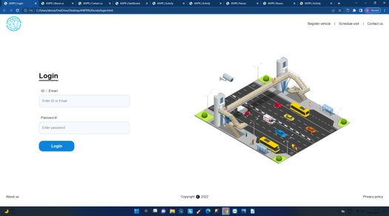
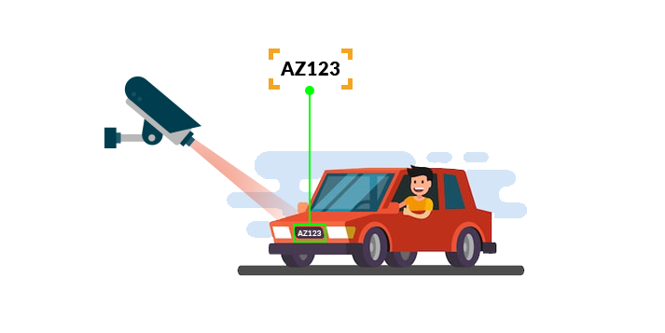
Automatic Number Plate Recognition (ANPR) Based Campus Security
Implemented camera vision & web-based solution to control the vehicular movement and automatic tracking across the university for enhance security of students and staffs
Challenges
Solution Highlights
More than 60 open gates connected to public access road across the university
ANPR camera-based monitoring:
Edge AI enabled ANPR camera installed at entry and exit gates
Data acquisition from the camera through existing network infrastructure
Web based Interface for the gate security & head of the security
Advanced features like pass generation for different type of visitors based on durations of stay, type of guest etc.
Comprehensive Report generation for the admin staff for vehicular traceability and gate management
There are no means to extract number plates and entry points from the existing CCTV infra
No traceability of vehicle once it entered at a particular gate
Difficulty for Security personnel to manage gates
Technologies
Python | HTML | Node.js | C/C++ | MSSQL | Linux | CSS | NGINX
Improved vehicular movement , traceability of the vehicles thus enhance the security of the university

Slide 14
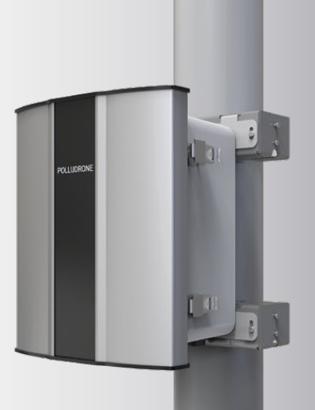
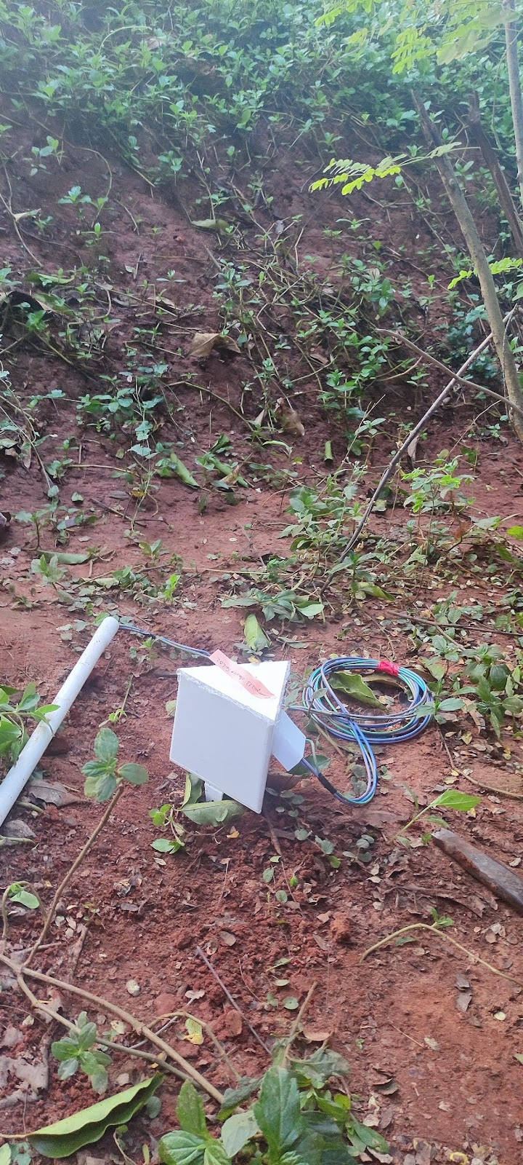
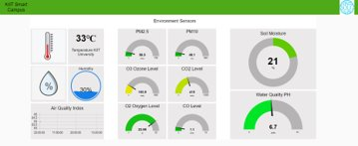

Monitoring Environment parameters such as Air Quality, Water Quality & Soil Moisture Content
Implemented IoT & cloud-based solution to determine the AQI, Water Quality & soil moisture content of different campuses of the university
Challenges
Solution Highlights
Continuous monitoring of
Air quality to measure AQI
Soil Quality to measure soil moisture
Water Quality to measure Ph, Turbidy & hardness at the point of dispensation
Actionable intelligence to facilitate corrective measures
Computing boards, communication between Azure IoT hub and sensors are encrypted
APIfication of the dataset allows external researchers / students to use the dataset for analytics
Infrequent monitoring of quality of water consumed
Monitoring of Air quality to understand the impact of green initiative taken by the university
Need to maintain the soil moisture to maintain the flora and fauna of the campus
Technologies
Python | MariaDB | Linux | Node Red | Azure IOT
Timely corrective measures taken by university to create healthy campus based on the data from the system

Slide 15
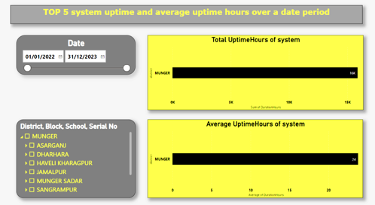
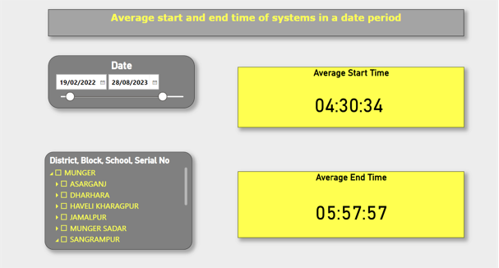
System usage (Equipment Hour) Monitoring for education department of an Indian state
Implemented cloud-based solution to monitor system utilization and report generation
Challenges
Solution Highlights
ERP system that keeps a track of usage of the system and alerts users for intervention
Daily crunching of system logs from 2000+ systems to calculate utilization
Analytics dashboard that gives real time as well as historical insights of the system utilization
Develop a platform to track usage and maintenance of 1000+ class rooms
Measure the utlization of systems deployed in smart classes
Provide real time insights to the functioning of aggregated as well as individual infrastructure
Technologies
Python | MariaDB | Azure IOT | Power BI | Shell Script | HTML | CSS
Imporoved system utilization by keeping record of total usage by sending real-time data

